Slide 1
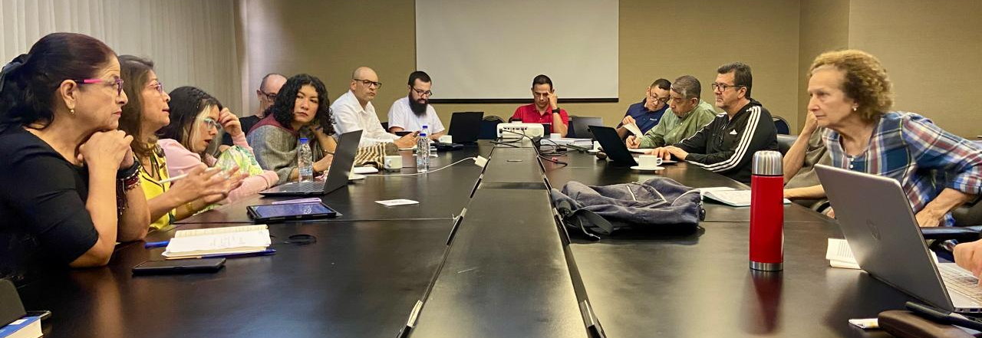
Dealing with Difficult Situations
This Photo by Unknown Author is licensed under CC BY
Dr Helen McLaughlin

Slide 2
Approach
30 years in Charity Sector
Leadership; Collaboration; Strategic Planning; Evaluation
Non-clinical
Leadership rather than management
Getting the best from your team

Slide 3
What we’ll cover
How teams operate
Dealing with difficult behaviours: Preventions
Dealing with difficult behaviours: Interventions
Management or Leadership?

Slide 4

Intros and Expectations
Please enter your name in the chat along with your expectations for the session; this will help the team plan future sessions.
Feel free to submit questions in the chat; we’ll have pauses during which the team will highlight some for my attention.
Be mindful of the information you share; avoid mentioning names, or identifiable circumstances or role descriptions.

Slide 5
Management or Leadership?
Management | Leadership
Planning and Organising | Including, encouraging
Assigning roles – instructing | Listening
Delivering targets | Developing
Ensuring people are where they’re meant to be, doing what they need to do | Communicating
Reporting | Observing, recognizing, addressing
Makes sure the job gets done. | Creates the culture in which the job gets done.

Slide 6
What constitutes difficult behaviour in teams? My experience
These people are difficult
This Behaviour is difficult
I am finding This behaviour difficult
Other People might find me Difficult – sometimes!

Slide 7


How teams operate
There are lots of “I”s in team!
We all see the world differently.

Slide 8

We all hear the world differently
Can you get me a sandwich for lunch tomorrow?
Can you get me a sandwich for lunch tomorrow?

Slide 9

We all hear the world differently
Can you bring me that report we need tomorrow?
Can you bring me that report we need tomorrow?

Slide 10

Planning a team celebration
Scenario:
We are a team.
We have all been given 3 days off to have a break in recognition of working in a very challenging situation – yes!
We have to go together…
This Photo by Unknown Author is licensed under CC BY-SA

Slide 11

What would you do first:
A. Identify a time in your calendar when you can plan your break properly
B: Start to identify options, check your bank account to see how much you can spend
C: Just head out the door and go
D: Envision the best possible break you can have in three days
E: Think of all the things that might stop you from going

Slide 12
The Team Spaces
A:
Plan
E:
We can’t do it!
C: Let’s do it
B: What are our options?
D:
This could be great!
Adapted from Interaction Institute for Social Change Facilitative Leadership Programme https://interactioninstitute.org/

Slide 13
From Harvard Business Review
Conflict can consume up to 40% of a manager’s time.
“We surveyed more than 1,000 first-time managers and their direct reports at 76 companies around the world. Across the board, we found that identifying the root cause, or trigger, of a stressful situation can mitigate conflict before it even begins. We concluded that four triggers cause the majority (91%) of conflict within organizations:
communication differences (39%)
opaque performance standards (14%)
unreasonable time constraints (16%)
unclear expectations (22%).
https://hbr.org/2022/05/conflict-is-not-always-bad-but-you-should-know-how-to-manage-it

Slide 14

Preventions: The Team Spaces - Understanding your Team
We all approach things differently and have a natural inclination to move around the spaces in our own order
Each space has a value – none of the spaces is “bad”
Plan how you’ll give your team the opportunity to move through the spaces depending on what level of team input / involvement is appropriate to the situation
Ensure everyone is in the same space at the same time
Sometimes we need help to get out of the space we’re stuck in so that we can get on with the job.

Slide 15

Preventions – Communication is key
Think about how you like to be communicated with – and how you communicate
Have a clearly understood code of communication within the team
Ensure:
Shared awareness of the task
Shared awareness of roles
Shared awareness of how plans and decisions are made
Clear boundaries especially around which decisions and plans team members can contribute to, and which they can’t.

Slide 16

Preventions
Have a clearly understood pathway for team members to ask questions, share concerns, clarify anything they are not sure of
Ensure that support is available
When you’re under pressure, how are you communicating with others?
GO SLOW TO GO FAST – what have you got time for?

Slide 17
Interventions – factors to consider
Step back - recognise patterns – what’s your analysis?
It is the whole team or an individual?
Is it a recurrent pattern within the team?
If it’s an HR situation, always stay within the appropriate HR guidance and process
If it’s not, is a one-to-one conversation appropriate?

Slide 18

The tools of an effective conversation: Inquiry and Advocacy

Slide 19
Inquiry
Ask for a conversation
Name it, recognize it:– collegiate, supportive, non-confrontational
Ask questions to get to the root cause
Check you have understood what the team member is saying – follow protocols of course if it is a serious concern, clinical, safeguarding etc.
If appropriate for the conversation to continue, ask what would help – with acknowledgement of constraints.

Slide 20

Examples of Inquiry Questions
“I noticed that…”
“Can you say more about why you were feeling like that in the meeting?”
“Can you tell me more about that?”
“Have I understood this correctly?” – summarise the concern as you understand it
“What do you think might help?” - bear in mind constraints, fairness etc.

Slide 21
Advocacy
Take note of what has been suggested
If a number of suggestions, work through and agree which one or two might help most. Bear in mind fairness and equity in the team
Agree appropriate next steps and timescale.

Slide 22
Advocacy
Advocacy
Follow up on what was agreed and review after agreed period.
If dealing with the issue immediately is not possible, defer – ask the team member to recognize that the issue cannot be dealt with immediately. Can they live with this until – and specify a timescale and plan of action – and always be realistic about the constraints
Ask “can you work with this” rather than “are you happy?”

Slide 23

Examples of Advocacy Questions
How does that sound?
Does that seem reasonable within the constraints in our context and within the team?
Can you work with this?
Repeat what has been agreed and ensure understanding
Shall we agree a timescale and a date when we can review?

Slide 24
In summary:
Get to know yourself and how you operate
Get to know your team and how they operate and Identity patterns
Put in place preventions
When intervention is needed, is it an HR situation, or a collegiate coaching conversation?
If it’s a conversation, ask before advocating.

Slide 25
More information
https://professional.dce.harvard.edu/
https://hbr.org/2022/05/conflict-is-not-always-bad-but-you-should-know-how-to-manage-it
https://professional.dce.harvard.edu/blog/preventing-and-managing-team-conflict/
https://interactioninstitute.org/
https://www.mindtools.com/
Bing Videos (Dr Bob Klaber, Imperial College, on kindness in healthcare)
https://commonslibrary.org/working-in-groups-start-here
https://www.belbin.com/about/belbin-team-roles

Slide 26

Thank-you!

